Slide 1
Talk Title
Speaker, Date, Other Info
www.LevyCIMAR.org | @LevyCIMAR

Slide 2
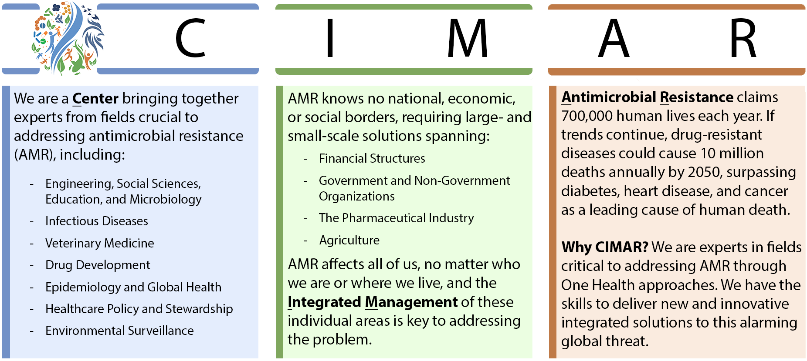
Our Mission:
Innovating to Protect Humanity from the Global Threat of Antimicrobial Resistance: Integrating Solutions Across Human and Veterinary Medicine, Stewardship, and Awareness

